Slide 1
Person Detection
from a
Top-View Perspective
Frontoni Emanuele
Mameli Marco
Paolanti Marina
Pazzaglia Giulia
Baldascino Giovanni - 1097405
Squarcella Loisi - 1096539

Slide 2
OUTLINE
Introduction
State of Art
Materials and Methods
Results and Discussions
Conclusion and Future Works
Person Detection
Feature based Techniques
One-stage Detectors
Single-shot Detectors
Labelling
Training
Evaluation
Fine Tuning
1

Slide 3
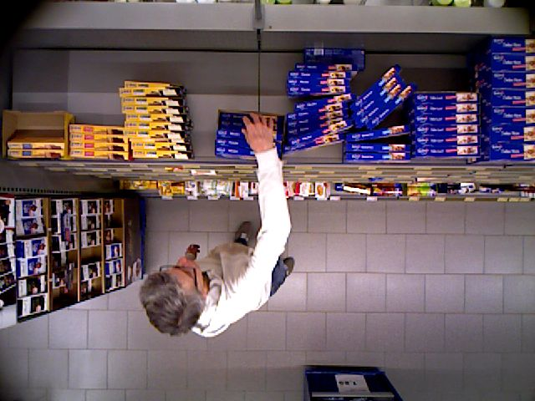
INTRODUCTION
Person Detection from a Top-View Perspective by using most recent object detection frameworks.
The aim is to build an efficient model to detect the people in the scene. The provided scenario is a retail environment.
2

Slide 4
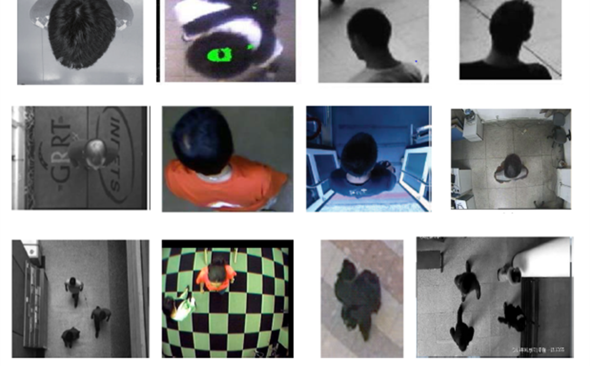
INTRODUCTION
MAIN STEPS:
Definition of the Region of Interest (ROI);
People localization.
3

Slide 5
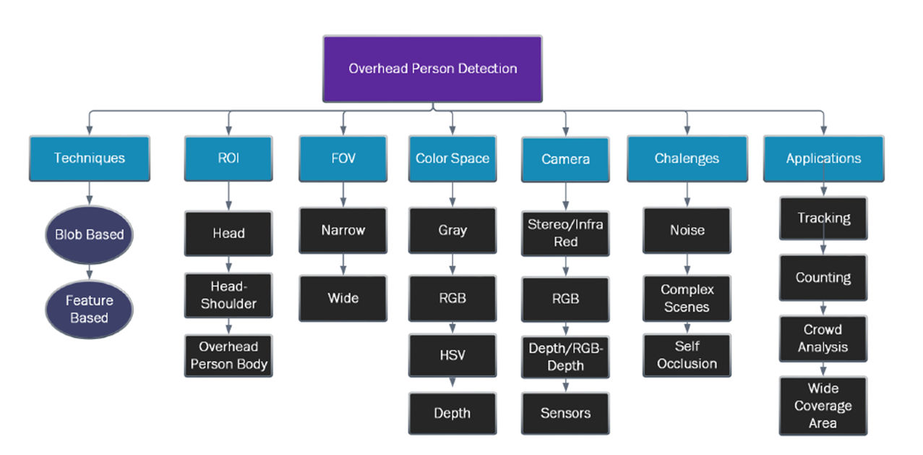
STATE OF ART – Person Detection
4

Slide 6
STATE OF ART – Person Detection
4

Slide 7
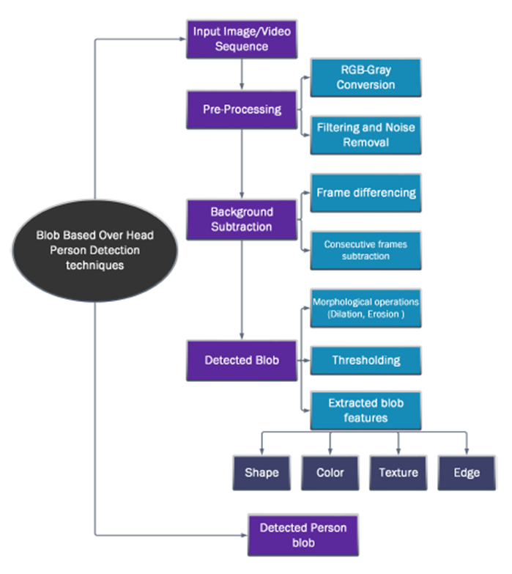
STATE OF ART – Person Detection
In Blob based Techniques a foreground image is obtained from background subtraction. Different pre-processing techniques are also used to remove noise, shadow and illumination.
5

Slide 8
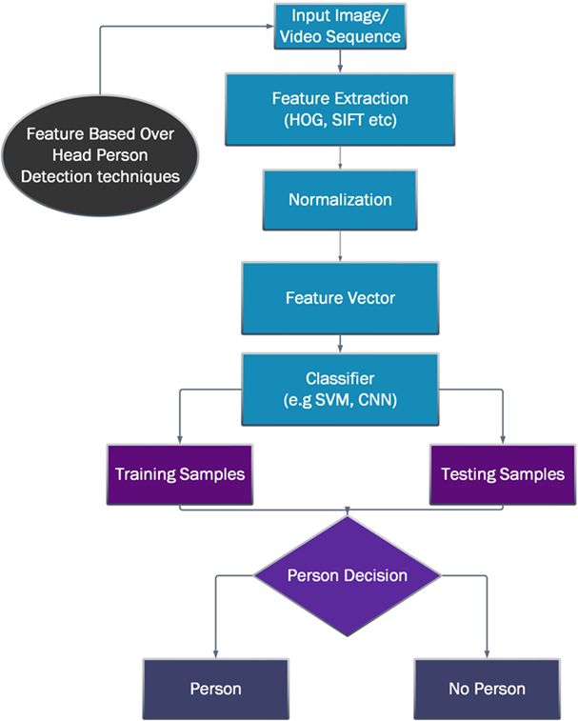
STATE OF ART – Person Detection
These Feature based Techniques operate on features extracted from overhead view videos and images.
The extracted features contain shape, color, texture, etc.… The images are often divided into samples for training and testing.
6

Slide 9
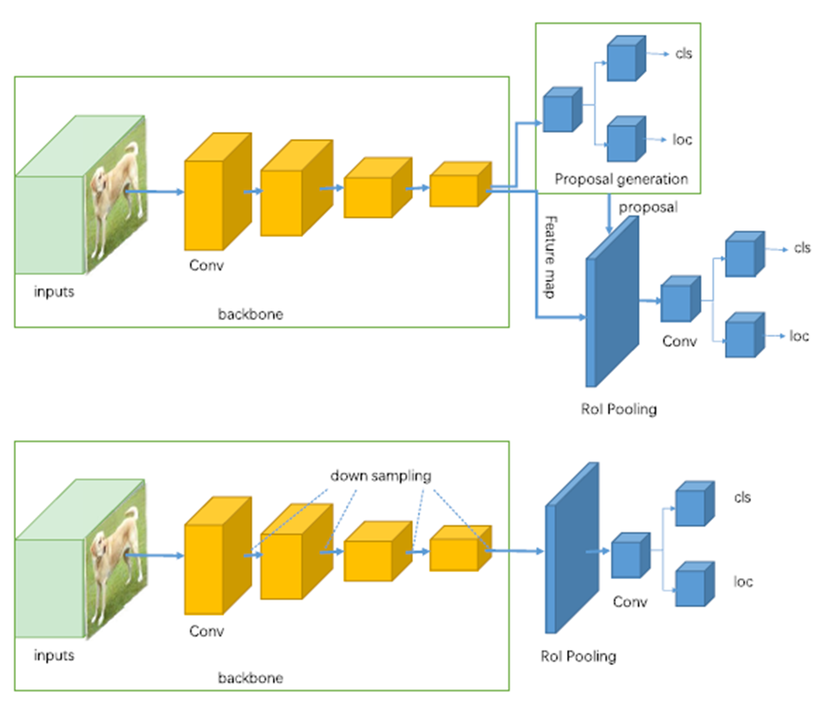
STATE OF ART – Feature based Techniques
Two-stage Detectors (R-CNN, Faster R-CNN, etc..) use a Region Proposal Network to generate regions of interests.
One-stage Detectors (YOLO, SSD, etc..) treat object detection as a simple regression problem.
7

Slide 10
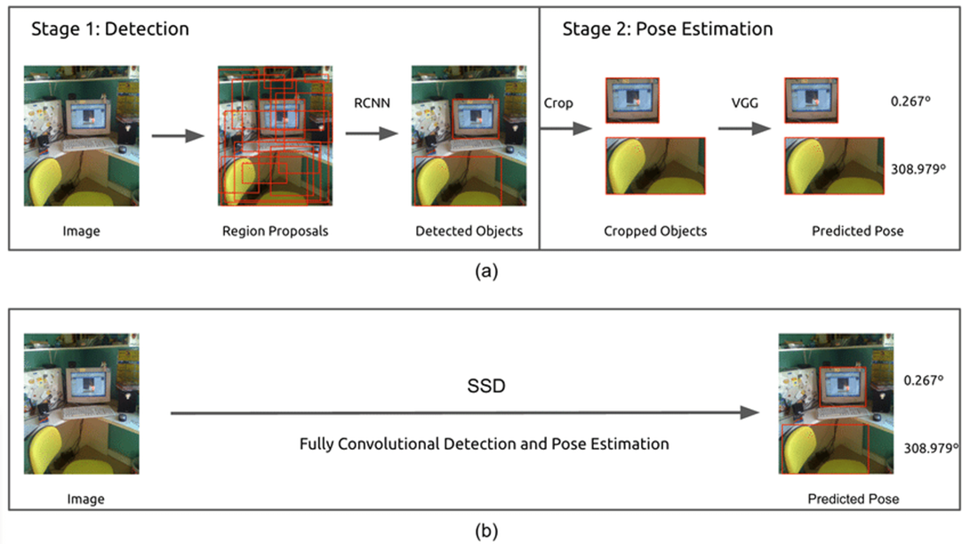
STATE OF ART – Feature based Techniques
(a) Two-stage Detector (b) One-stage Detector
8

Slide 11

STATE OF ART – Feature based Techniques
VGG16 (Visual Geometry Group) is one of the architecture for feature extraction.
7

Slide 12
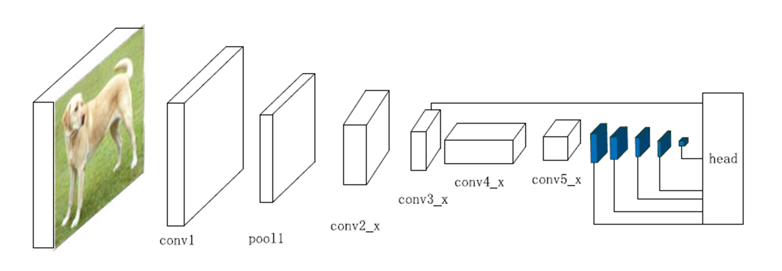
STATE OF ART – One-stage Detector
SSD (Single-shot Detector) discretizes the output space of bounding boxes into a set of default boxes over different aspect ratios and scales per feature map location.
In SSD the prediction layer is acting on fused features of different levels. Head module consists of a series of convolutional layers followed by several classification layers and localization layers.
9

Slide 13
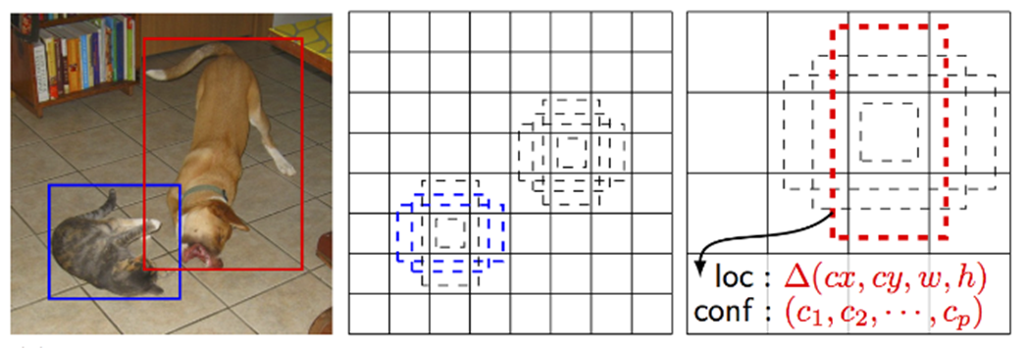
STATE OF ART – Single-shot Detector
Each prediction is composed of:
Bounding box with shape offset (∆cx, ∆cy, w and h);
Confidences for all object categories or all the classes.
10

Slide 14
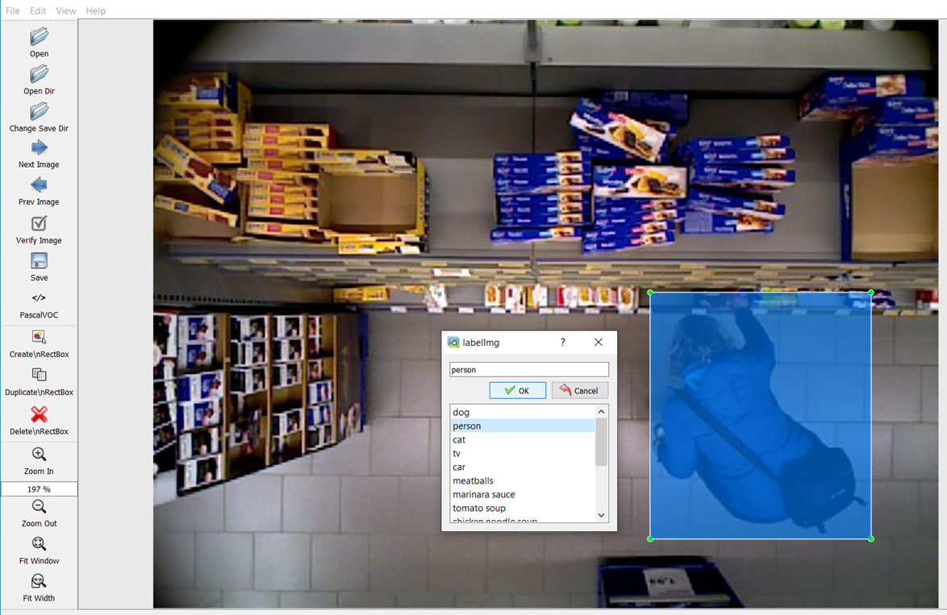
MATERIALS AND METHODS – Labelling
Dataset annotation using LabelImg. LabelImg is a graphical image annotation tool.
Training set → 70%
Testing set → 30%
Validation set → 30% of training set
11

Slide 15
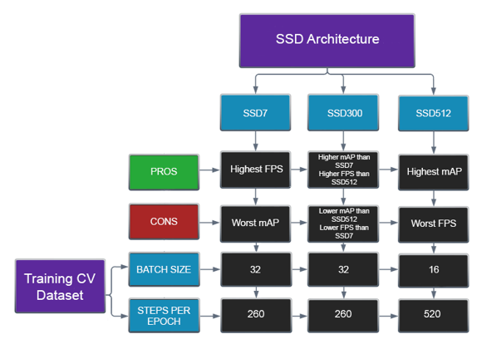
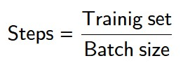
MATERIALS AND METHODS – Training
Epochs: 40
Learning rate: 0,001
14

Slide 16
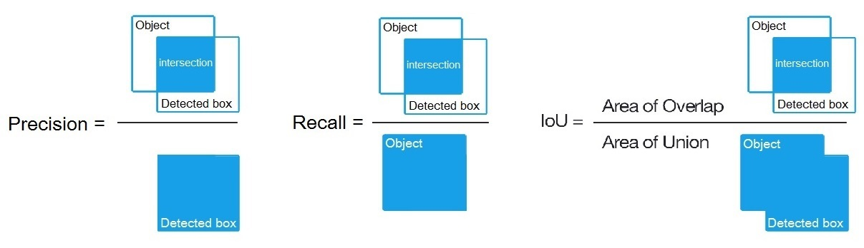
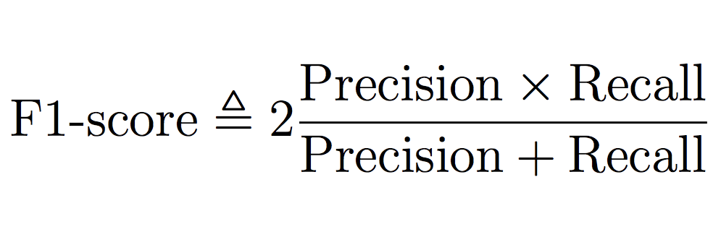
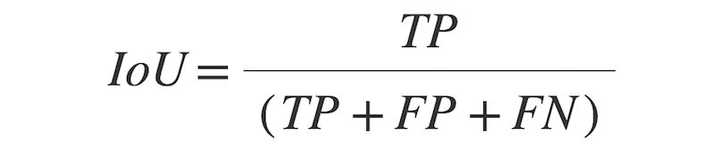
MATERIALS AND METHODS – Training
During the training, two metrics were used to compute the loss and validation loss:
F1 score
Intersection over Union (IoU)
14

Slide 17
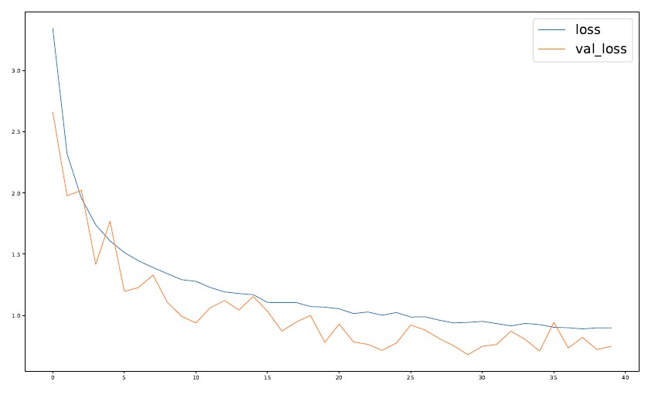
MATERIALS AND METHODS – Training
SSD7
14

Slide 18
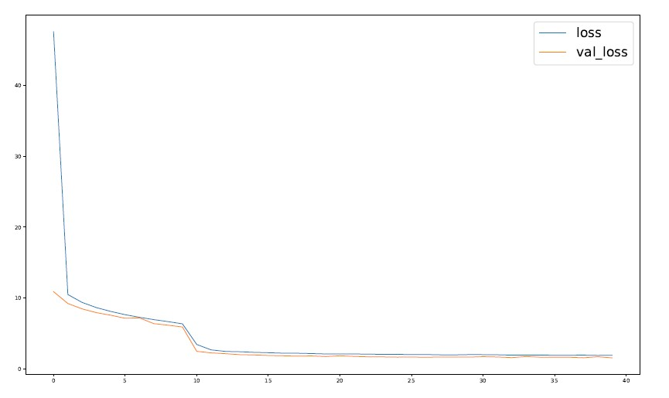
MATERIALS AND METHODS – Training
SSD300
14

Slide 19
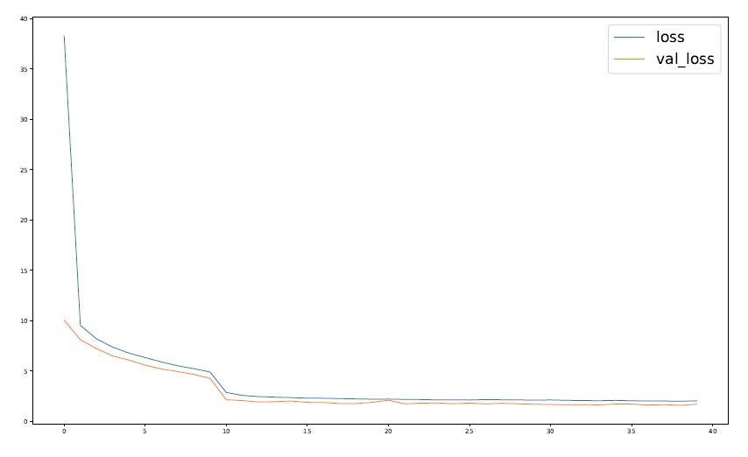
MATERIALS AND METHODS – Training
SSD512
14

Slide 20
MATERIALS AND METHODS – Evaluate
The metrics used for the evaluation are AP (Average Precision), Recall and IoU (Intersection over Union).
ADD IMAGES, GRAPHS OR TABLES
16

Slide 21
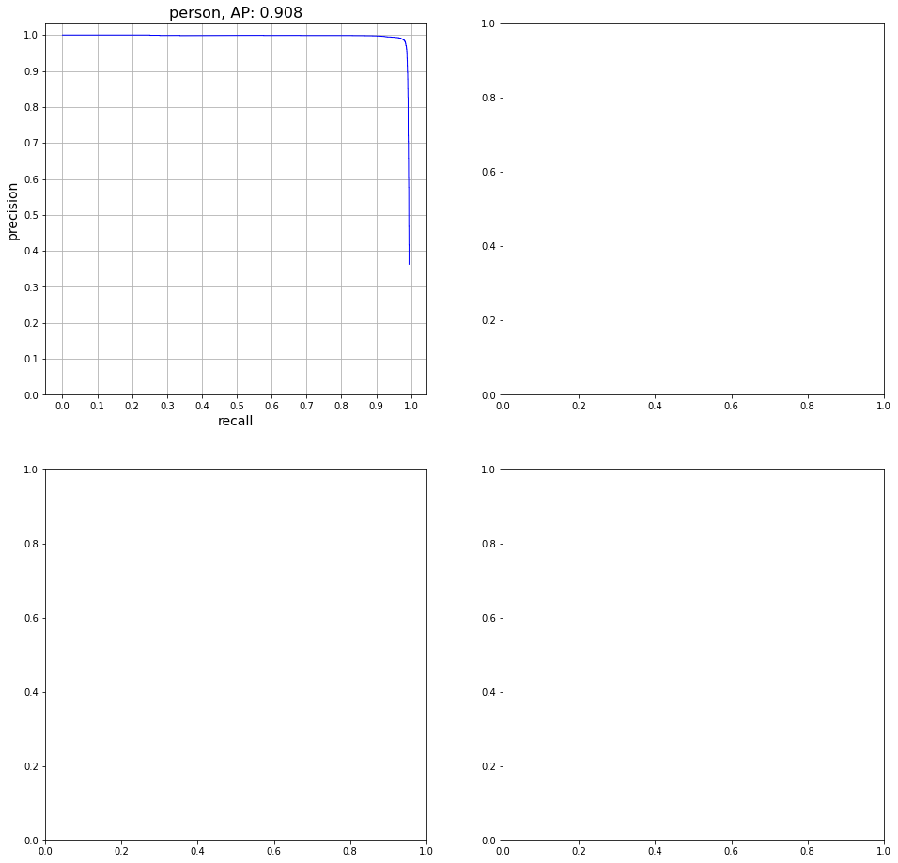
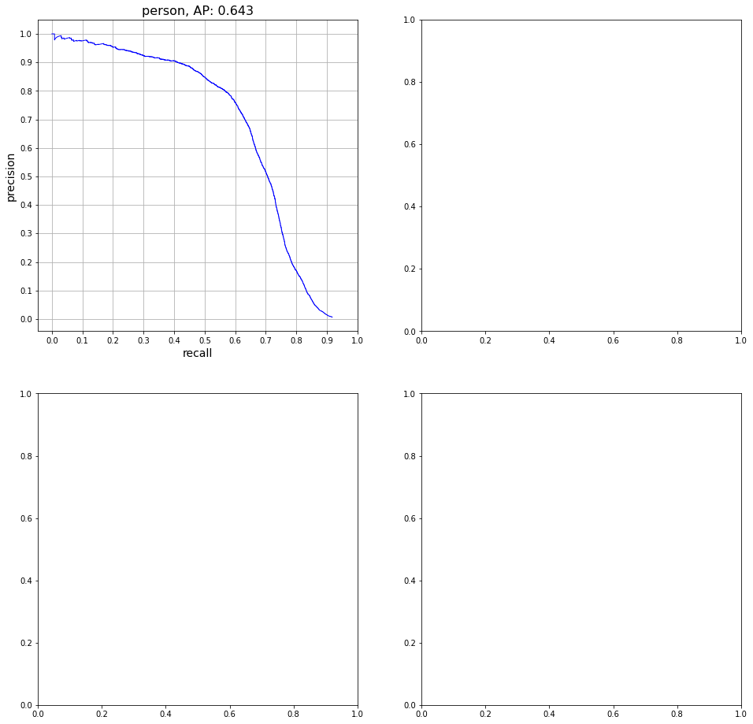
MATERIALS AND METHODS – Fine Tuning
The SSD300 and SSD512 presented weights related to models already trained on the Pascal VOC 07 + 12 dataset; a fine tuning of the weights was made to go from 20 classes to the only <person> class.
SSD300 trained from scratch
SSD300 after fine tuning
15

Slide 22
TODO
Sostituzione architettura VGG16 con simili (ES. Resnet50);
Continuare a fare training (se serve);
Continuare a cercare architetture ‘migliori’.
PROBLEM
Compute loss with IoU and F1
Order of pred boxes
SSD7 inf and eva

Slide 23
THANKS FOR WATCHING

